Slide 1
Workshop Ancient Text Analysis
Martijn Naaijer
mna@teol.ku.dk

Slide 2
Goals
Thinking about:
- integrating digital tools and datasets in you own education and research?
- how to make your own annotated datasets.
- what a quantitative approach can add to traditional linguistic/exegetical/historical approaches?

Slide 3
What do we do?
Explore annotated corpora with Text-Fabric:
Hebrew Bible
New Testament
Quran
Query texts & explore the annotations.
Make basic analyses.
Visualize results of queries and analyses.
Annotate a raw English text (spaCy).
Find groups in multiple manuscripts of one Greek text.

Slide 4
Text-Fabric
“Python package for processing annotated text datasets.”
Developed by Dirk Roorda.
We will explore different texts with different annotations, but the way we access them is identical.
Make queries with Search in browser or in Python script.

Slide 5
Why Text-Fabric?
It is free.
Easy to use.
It is open.
You can become part of the TF project by contributing:
Make TF datasets using your own annotated datasets.

Slide 6
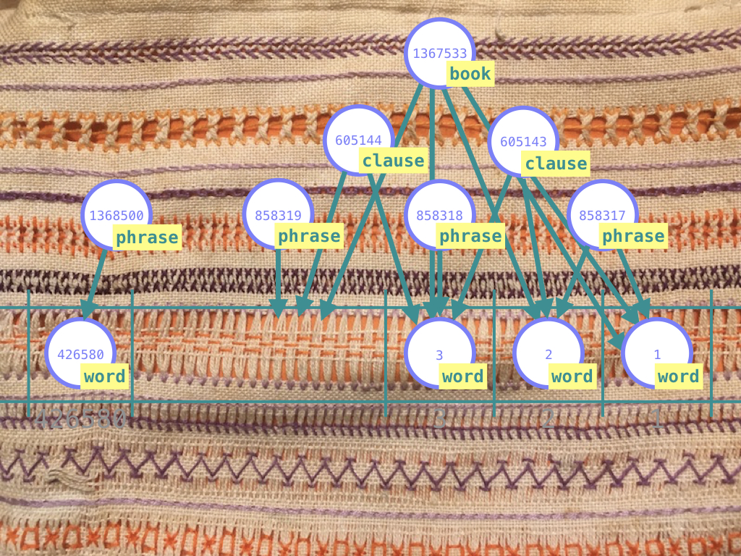
Graph structure of TF dataset

Slide 7
Assignments
Make a mini project after each meeting:
Research problem/question.
Make queries/analyses.
Present in next meeting (3-5 minutes).

Slide 8
6 meetings
1. Intro and Hebrew Bible.
2. NT and Quran.
3. Visualizations with Python/Seaborn.
4. Text-Fabric and the Pure Python approach/Classical Language Toolkit.
5. Making an annotated dataset with Spacy: KJV.
6. Clustering texts (Letter of Jude) with Sklearn.

